Slide 1
Project 1
FinTech bootcamp
Group Members
Roshan Paudyal
Asha Devi
Project Presentation Date : 17 January 2023
Notes:
Roshan – Slides – 1- 5 Roshan – Slides 14 - 16

Slide 2

Analysis conducted and the outcomes of this project are purely for learning and development purposes. We do not accept any responsibility for the accuracy, completeness or currency of the material included in this project and will not be liable for any loss or damage arising out of any use of, or reliance on, this project outcomes.
This Photo by Unknown Author is licensed under CC BY

Slide 3
Motivation & Summary
Analysis on Superannuation products
Superannuation – Money saved for retirement
There is not much insight available regarding the superannuation products comparisons in the market.
Australian annual superannuation data collection is still relatively new.
APRA is still in its early phase of a new data collection, systems and processes for collecting and reporting data in accordance with the new reporting requirements and are not fully embedded across the industry.
We thought to give a try and see what we find with the available data on APRA website.
Our project is about analyzing the Australian Superannuation Funds for period 30 June 2014 to 30 June 2022. Analysis is around demography, fund types, member benefit flows and financial performance.
Notes:
This limits the users in gaining deep insights into the super products and impacting their efficient decision making.

Slide 4
Questions & Data
Data source: Australian Prudential Regulation Authority (APRA) website
File type: Excel format
Questions Posed:
Which fund has the maximum number of members accounts?
Which gender group holds maximum number of fund accounts?
What is the trend in the member accounts by age group?
Which sector has the maximum and minimum number of funds?
Which sector received the maximum contribution and from whom?
Which fund has the highest investment income?
Which fund has the lowest investment income?

Slide 5
Data Cleanup & Exploration
Data Exploration:
Data file with multiple sheets and header rows – which we did not anticipated.
Coding challenges - multiple sheets and header rows
Data Clean-up:
Some clean-up at the file level itself:
Removed the unwanted header rows and kept only one header row.
fixing blank fields and * in the cells, renaming the headers before attempting coding in Jupiter lab / visual studio.
Clean-up in the Jupiter lab:
Retrieve DataFrame shape to view the total number of rows and columns.
Identify series count, check for null values, check duplicates, view the DataFrame.
Reordering the columns by creating a new DataFrame
Set index, sort values, rename

Slide 6
Data Analysis
Section 1 – Demographics analysis (gender and age)
Section 2 – Fund types, member benefit flows and financial performance analysis
Data analysis continues…
Notes:
Asha – Slides 6 - 13

Slide 7
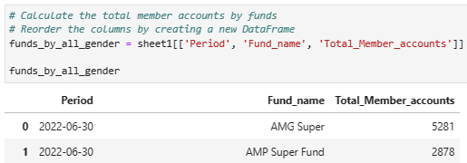
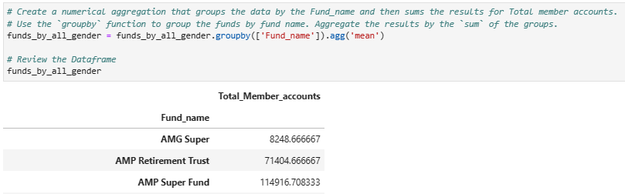
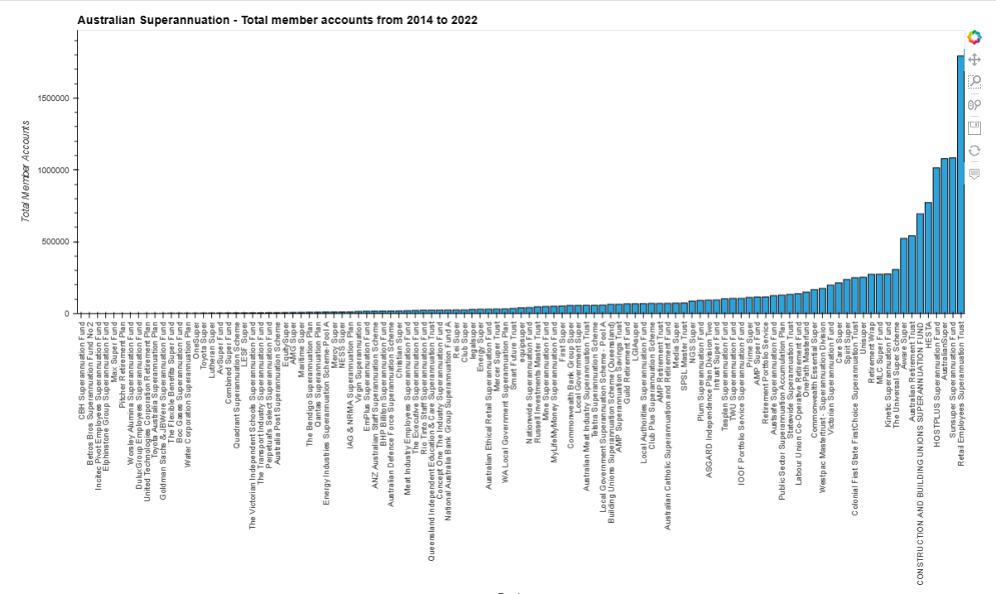
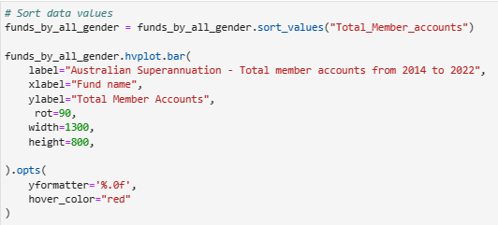
Data Analysis
Q1 - Which fund has the maximum number of members accounts?
Answer - Retail Employees Superannuation Trust
Steps taken to analyse the data:
View the full DataFrame first
Reorder the columns by creating a new Dataframe and select the columns that is relevant to this question.
Create a numerical aggregation that groups the data by the Fund_name and then sums the results for Total member accounts.
Sort data values and plot the visualisation
Data analysis continues…

Slide 8
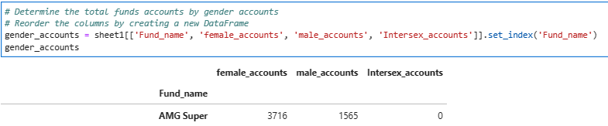
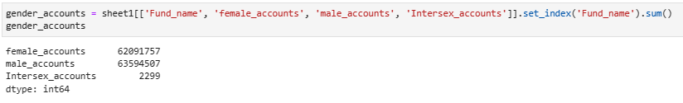
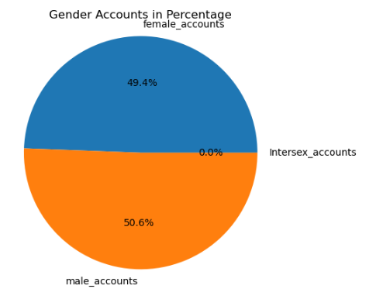
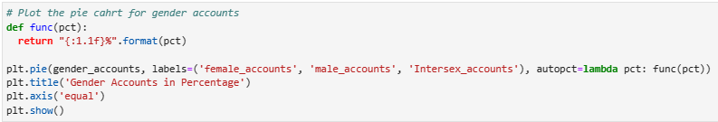
Data Analysis
Q2 - Which gender group holds maximum number of fund accounts?
Answer - Plot indicates that there is not much difference between the male and female total accounts whereas the intersex total accounts numbers are almost negligible.
Steps taken to analyse the data:
Determine the total funds accounts by gender accounts
Reorder the columns by creating a new DataFrame
Plot the Pie chart for gender accounts
Data analysis continues…

Slide 9
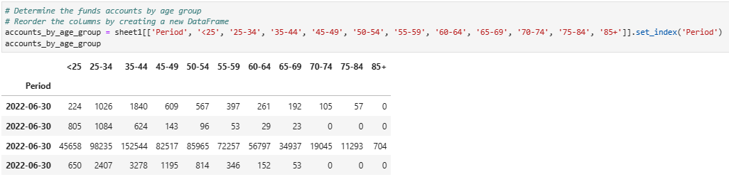
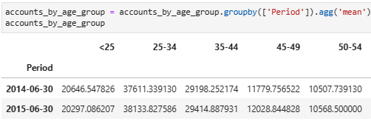
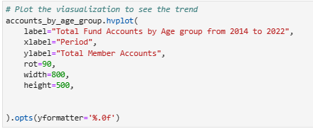
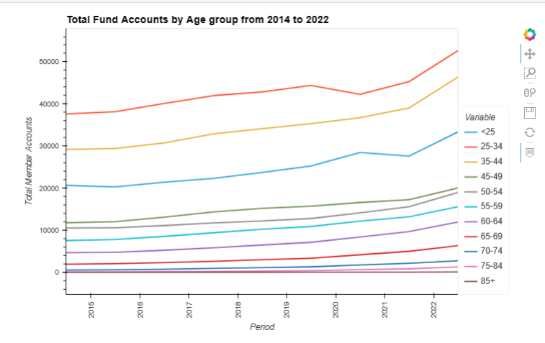
Data Analysis
Q3 - What is the trend in the member accounts by age group?
Answer - Plot shows that the funds for most of the age groups are trending upwards with period.
Steps taken to analyse the data:
Reorder the columns by creating a new DataFrame
Group the DataFrame by Period and aggregate the data by mean
Use the hvplot function to plot the visualization to see the trend
Data analysis continues…

Slide 10
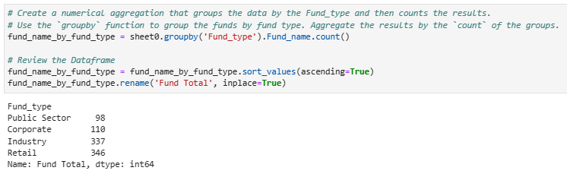
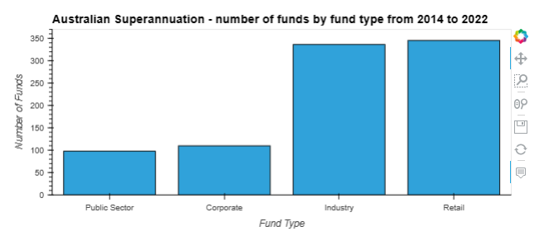
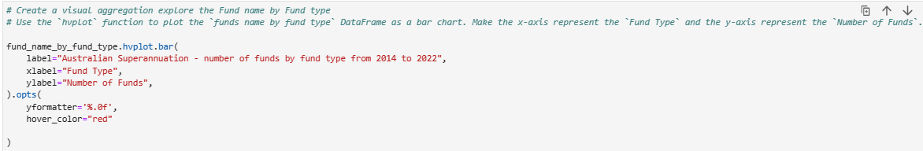
Data Analysis
Q4 - Which sector has the maximum and minimum number of funds?
Answer - Retail sector has the maximum number of funds followed by Industry sector whereas, Public sector has the minimum number of funds followed by corporate sector.
Steps taken to analyse the data:
Use the `groupby` function to group the funds by fund type. Aggregate the results by the `count` of the groups.
Use the `hvplot` function to plot the `funds name by fund type` DataFrame as a bar chart. Make the x-axis represent the `Fund Type` and the y-axis represent the `Number of Funds`.
Data analysis continues…

Slide 11
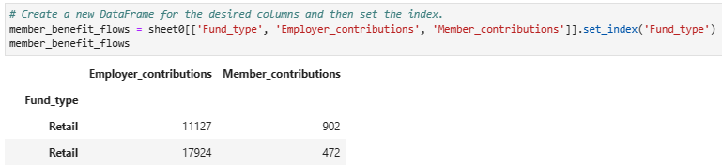
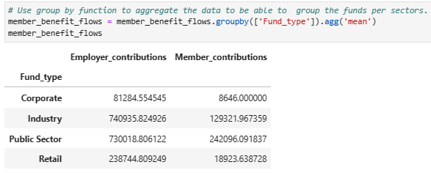
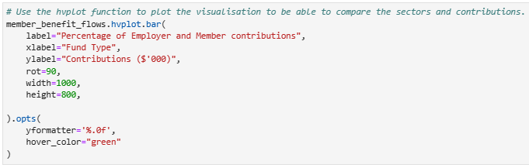
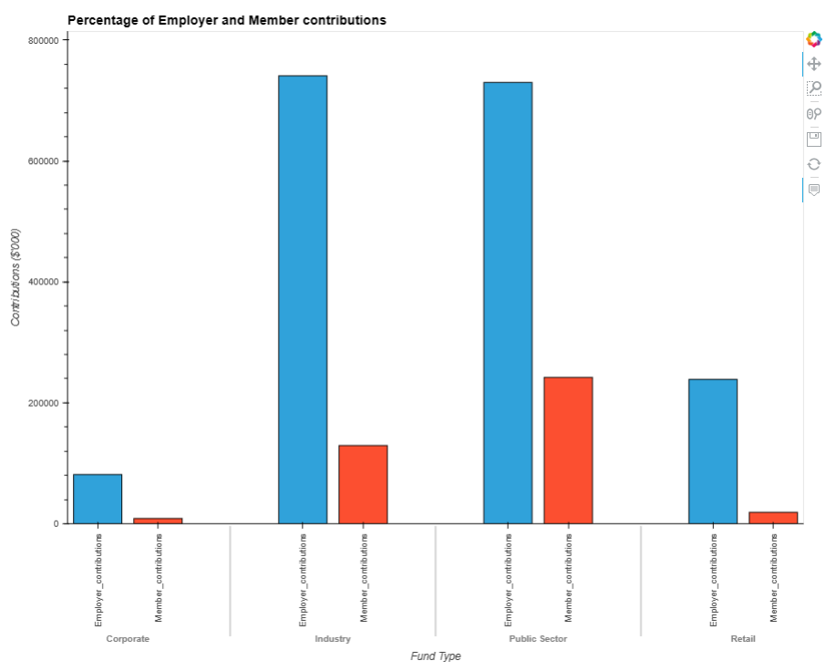
Data Analysis
Q5 - Which sector received the maximum contribution and from whom?
Answer - Industry sector received the maximum contribution from employer.
Steps taken to analyse the data:
Create a new DataFrame for the desired columns and then set the index.
Use group by function to aggregate the data to be able to group the funds per sectors.
Use the hvplot function to plot the visualisation to be able to compare the sectors and contributions.
Data analysis continues…

Slide 12
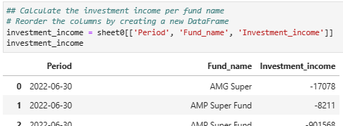

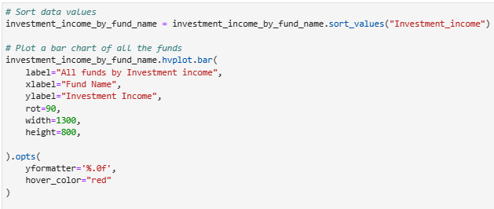
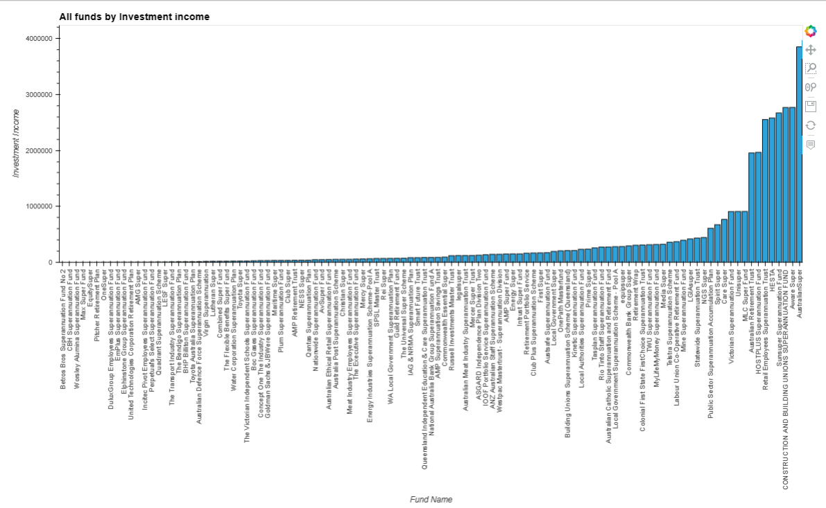
Data Analysis
Q6 - Which fund has the highest investment income?
Answer - Australian Super
Steps taken to analyse the data:
Create a new DataFrame for the desired columns and then set the index.
Reorder the columns by creating a new DataFrame
Group by Period and Fund_name and then create a new dataframe of the mean values
Use the hvplot function to plot the visualisation to be able to compare the sectors and contributions.
Data analysis continues…

Slide 13
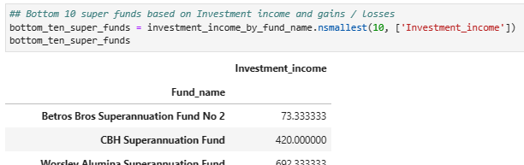
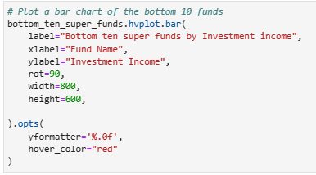
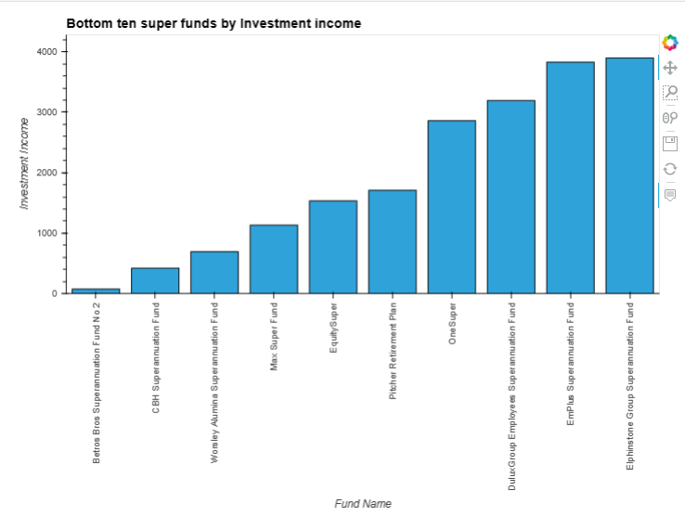
Data Analysis
Q7 - Which fund has the lowest investment income?
Answer - Betros Bros Superannuation om Fund No 2
Steps taken to analyse the data:
Determine the bottom ten funds by using nsmallest function.
Use hvplot to visualize the outcome.
Data analysis continues…

Slide 14
Discussion
FINDINGS
Plot indicates that there is not much difference between the male and female total accounts whereas the intersex total accounts numbers are almost negligible
Age group 25-34 has the maximum number of superannuation accounts . This indicates that this age group has more working head counts.
Retails sector holds the maximum number of funds whereas Public sector holds the least.
Top ten funds by investment income there is a big gap between top performer and rest of the nine funds.
Data analysis continues…
Notes:
Roshan – Slides 14 - 16

Slide 15
Postmortem
CHALLENGES & RESOLUTION
Data with multiple sheets and header rows. There was a Coding challenges for multiple sheets and header rows. So, we normalised the data file by removing the unwanted header rows and finding the file path code for multiple sheets.
ADDITIONAL QUESTIONS AROSE BUT UNABLE TO ATTEMPT DUE TO TIME CONSTRAINT.
Compare the performance of investment income for all the funds but due to the complexity of the file structure and time constraint we were unbale to attempt.
WHAT WOULD YOU RESEARCH NEXT IF YOU HAD TWO MORE WEEKS?
Data analysis continues…

Slide 16
QUESTIONS?
Data analysis continues…

